Slide 1
A Universal Turing Machine
Courtesy Costas Busch - RPI
1

Slide 2
A limitation of Turing Machines:
Turing Machines are “hardwired”
they execute
only one program
Real Computers are re-programmable
Courtesy Costas Busch - RPI
2

Slide 3
Solution:
Universal Turing Machine
Attributes:
Reprogrammable machine
Simulates any other Turing Machine
Courtesy Costas Busch - RPI
3

Slide 4

Universal Turing Machine
simulates any other Turing Machine
Input of Universal Turing Machine:
Description of transitions of
Initial tape contents of
Courtesy Costas Busch - RPI
4

Slide 5
Tape 1
Three tapes
Description of
Universal
Turing
Machine
Tape 2
Tape Contents of
Tape 3
State of
Courtesy Costas Busch - RPI
5

Slide 6
Tape 1
Description of
We describe Turing machine
as a string of symbols:
We encode as a string of symbols
Courtesy Costas Busch - RPI
6

Slide 7








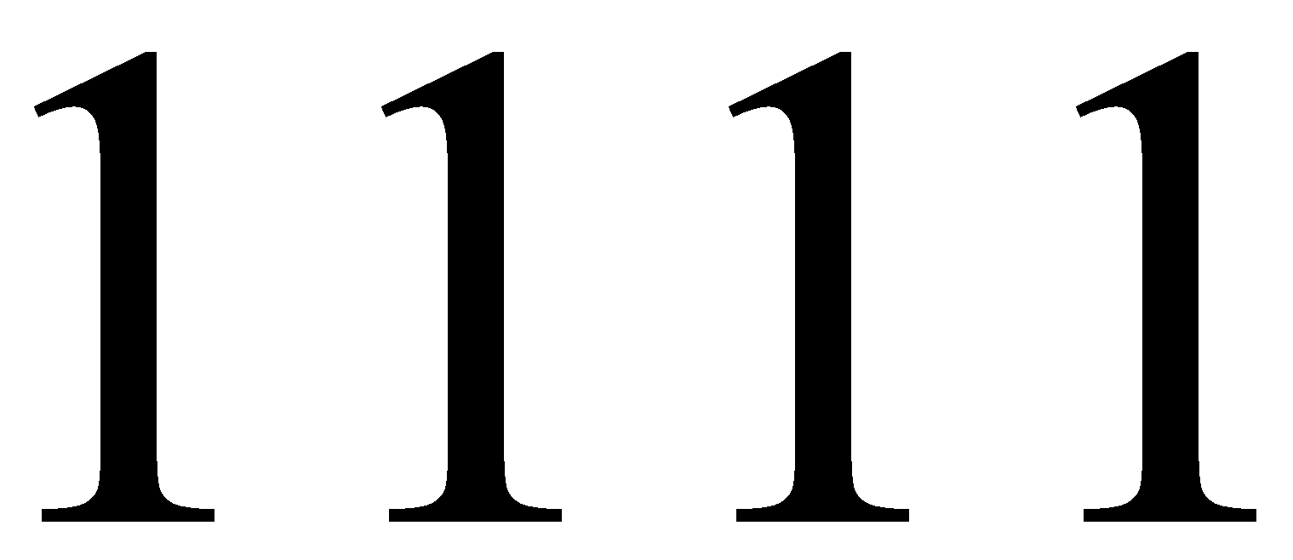
Alphabet Encoding
Symbols:
Encoding:
Courtesy Costas Busch - RPI
7

Slide 8
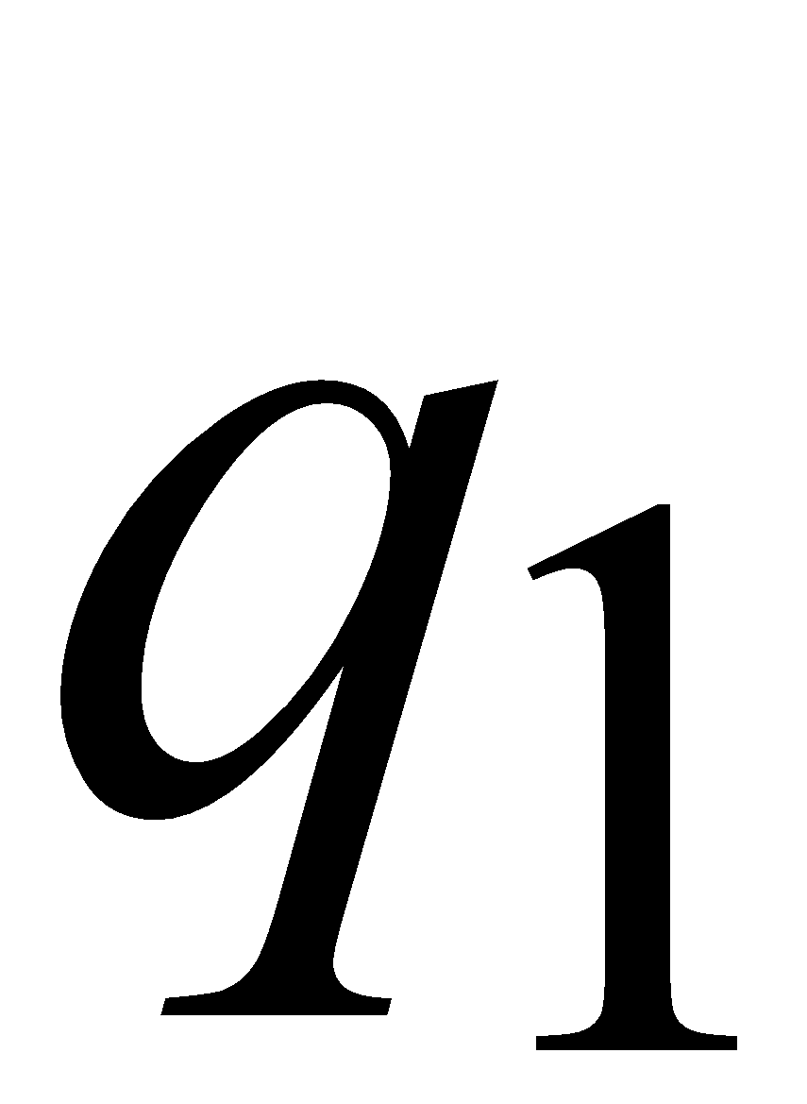
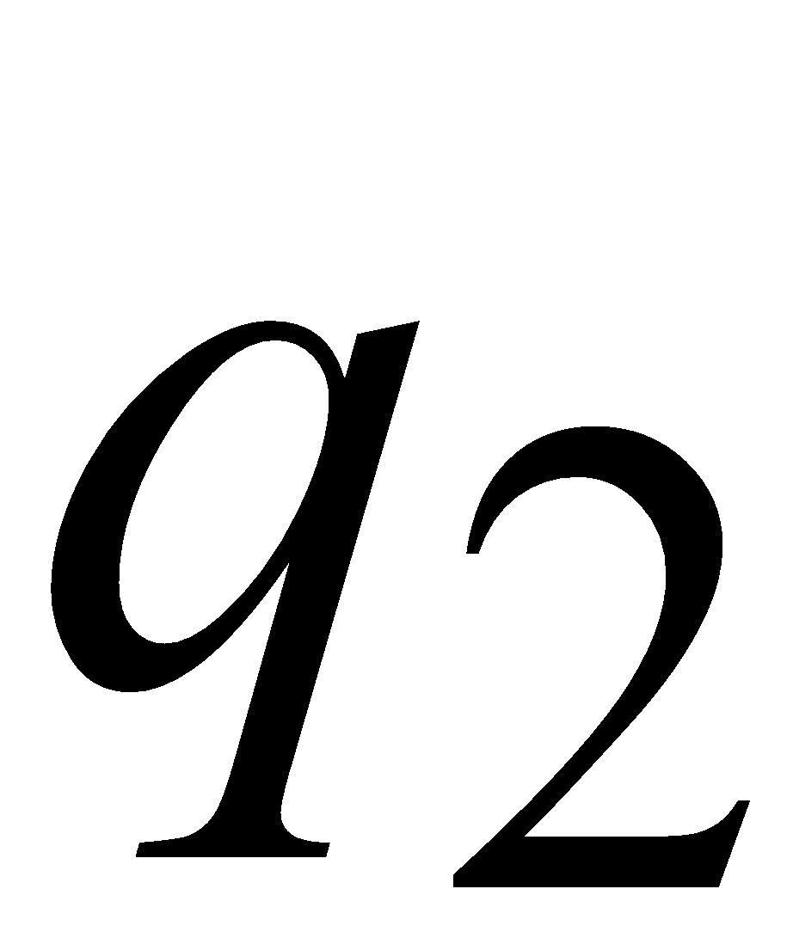
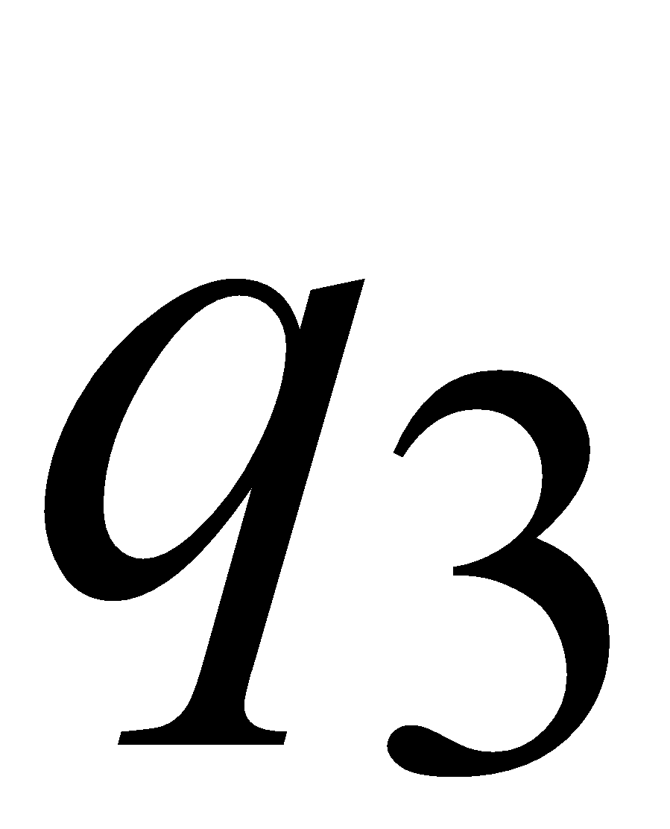
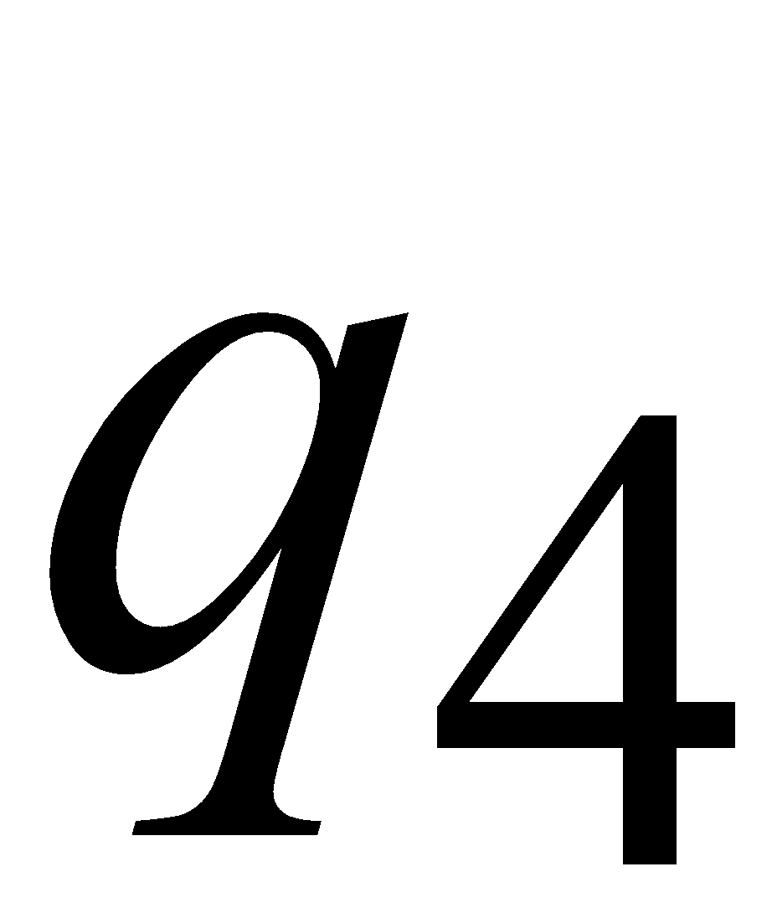


State Encoding
States:
Encoding:
Head Move Encoding
Move:
Encoding:
Courtesy Costas Busch - RPI
8

Slide 9
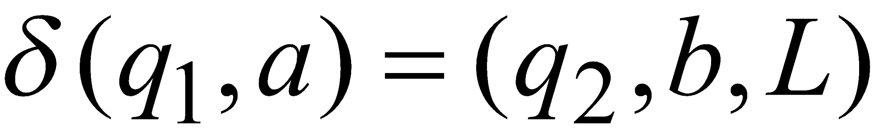
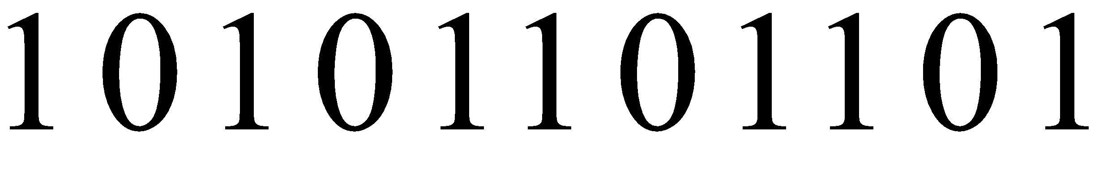
Transition Encoding
Transition:
Encoding:
separator
Courtesy Costas Busch - RPI
9

Slide 10
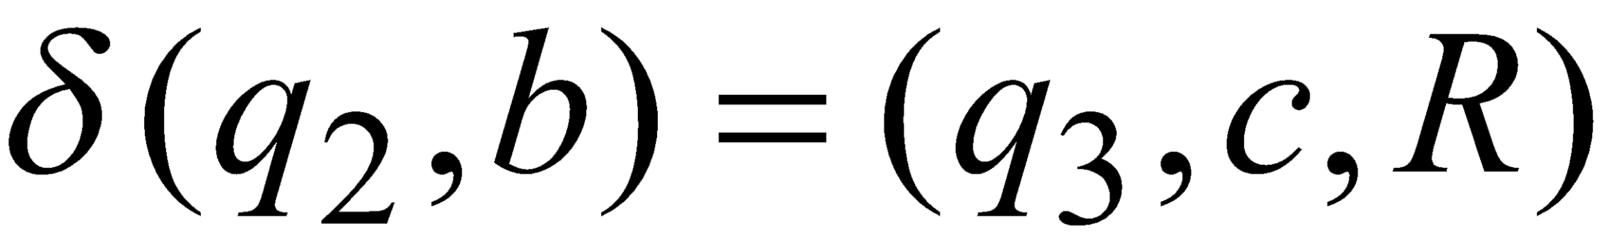

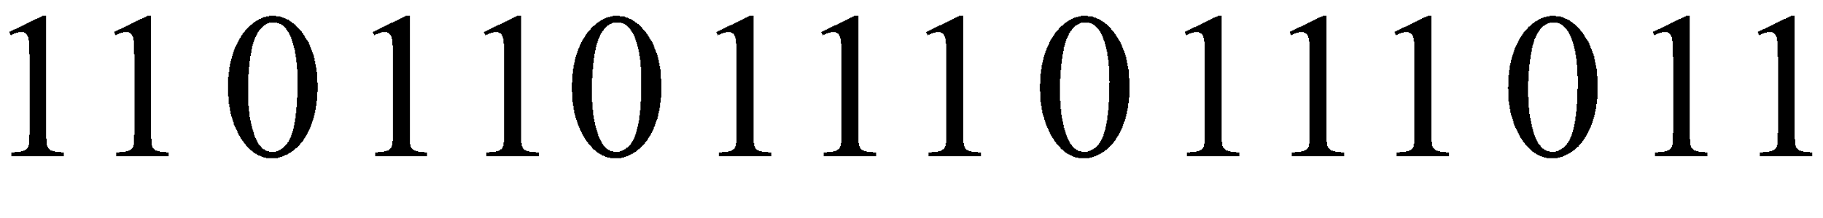
Machine Encoding
Transitions:
Encoding:
separator
Courtesy Costas Busch - RPI
10

Slide 11
Tape 1 contents of Universal Turing Machine:
encoding of the simulated machine
as a binary string of 0’s and 1’s
Courtesy Costas Busch - RPI
11

Slide 12
A Turing Machine is described
with a binary string of 0’s and 1’s
Therefore:
The set of Turing machines forms a language:
each string of the language is
the binary encoding of a Turing Machine
Courtesy Costas Busch - RPI
12

Slide 13
Language of Turing Machines
L = { 010100101,
00100100101111,
111010011110010101,
…… }
(Turing Machine 1)
(Turing Machine 2)
……
Courtesy Costas Busch - RPI
13

Slide 14


Non Recursively Enumerable
Recursively Enumerable
Recursive
Courtesy Costas Busch - RPI
14

Slide 15
The Chomsky Hierarchy
Non Turing-Acceptable
Turing-Acceptable
decidable
Context-sensitive
Context-free
Regular
15
Prof. Busch - LSU

Slide 16
The Chomsky Hierarchy
Non-recursively enumerable
Recursively-enumerable
Recursive
Context-sensitive
Context-free
Regular
Courtesy Costas Busch - RPI
16

Slide 17
The Curtain Falls on the ToA Course
Best of Luck
Courtesy Costas Busch - RPI
17

